Slide 1
First Grade Orientation
Mrs. Malland’s Class
August 2024

Slide 2
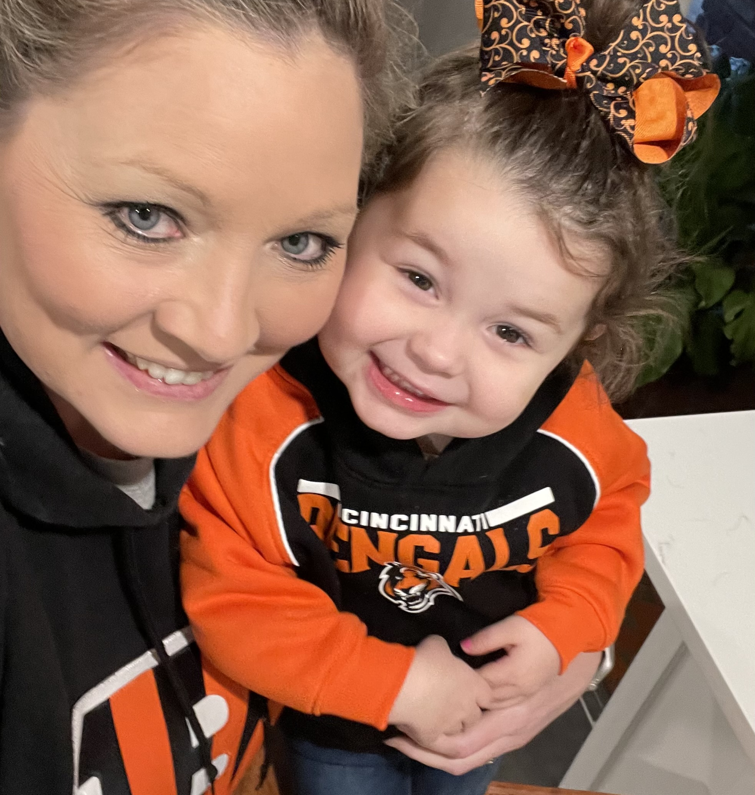
It’s Me, Hi…
22nd year teaching
2 years 5th grade optional (Peabody)
14 years kindergarten (Peabody)
5 years first grade (Richland)
^{6th} year at Richland

Slide 3
Supplies
RECOMMENDED
Headphones (small, foldable if possible) no earbuds
Post-it notes
Sock (to use as an eraser)

Slide 4
What to Expect
You may hear:
  I don’t want to go to school
  I want to go back to kindergarten
  I miss Mrs. _____ (Smith, Caldwell, Hulgan, Hunt, Rogers, Langston)
  I don’t like 1st grade
  1st grade is not fun
  Mrs. Malland won’t help me
Here is why:
  They came to know what to expect in kindergarten and formed a strong bond with that teacher; it was familiar and comfortable
  We just haven’t gotten there yet, but we will
  The first few weeks are not as “fun” because we spend a lot of time learning new routines and procedures (they also don’t remember that part of kinder)
  There is a HUGE jump in curriculum/grades and more is expected to be done independently (equates to me not helping them)

Slide 5
School Schedule
8:05 - 8:15am – Announcements and “Do Now”
8:15 - 8:30 – Morning Meeting
8:30 -10:30 – ELA and workstations/small groups
10:30 -11:00 Lunch
11:00 -12:30 – Math and science/social studies
12:30 -1:00 Recess
1:15 -2:00 – BOOST! (coming up)
2:05 -3:05 encore
3:05 – Pack up
3:10 - Dismiss

Slide 6
Encore Classes
Monday = P.E
Tuesday = n/a
Wednesday = library and Spanish
Thursday = music
Friday = art

Slide 7
Boost
Students will change classes and go to a room with another first-grade teacher based on their area of need (based on benchmark assessments).
Phonemic Awareness
High Frequency Words
Fluency
Writing
Comprehension
Vocabulary
Enrichment
*Math
**iReady will also be a part of daily intervention

Slide 8
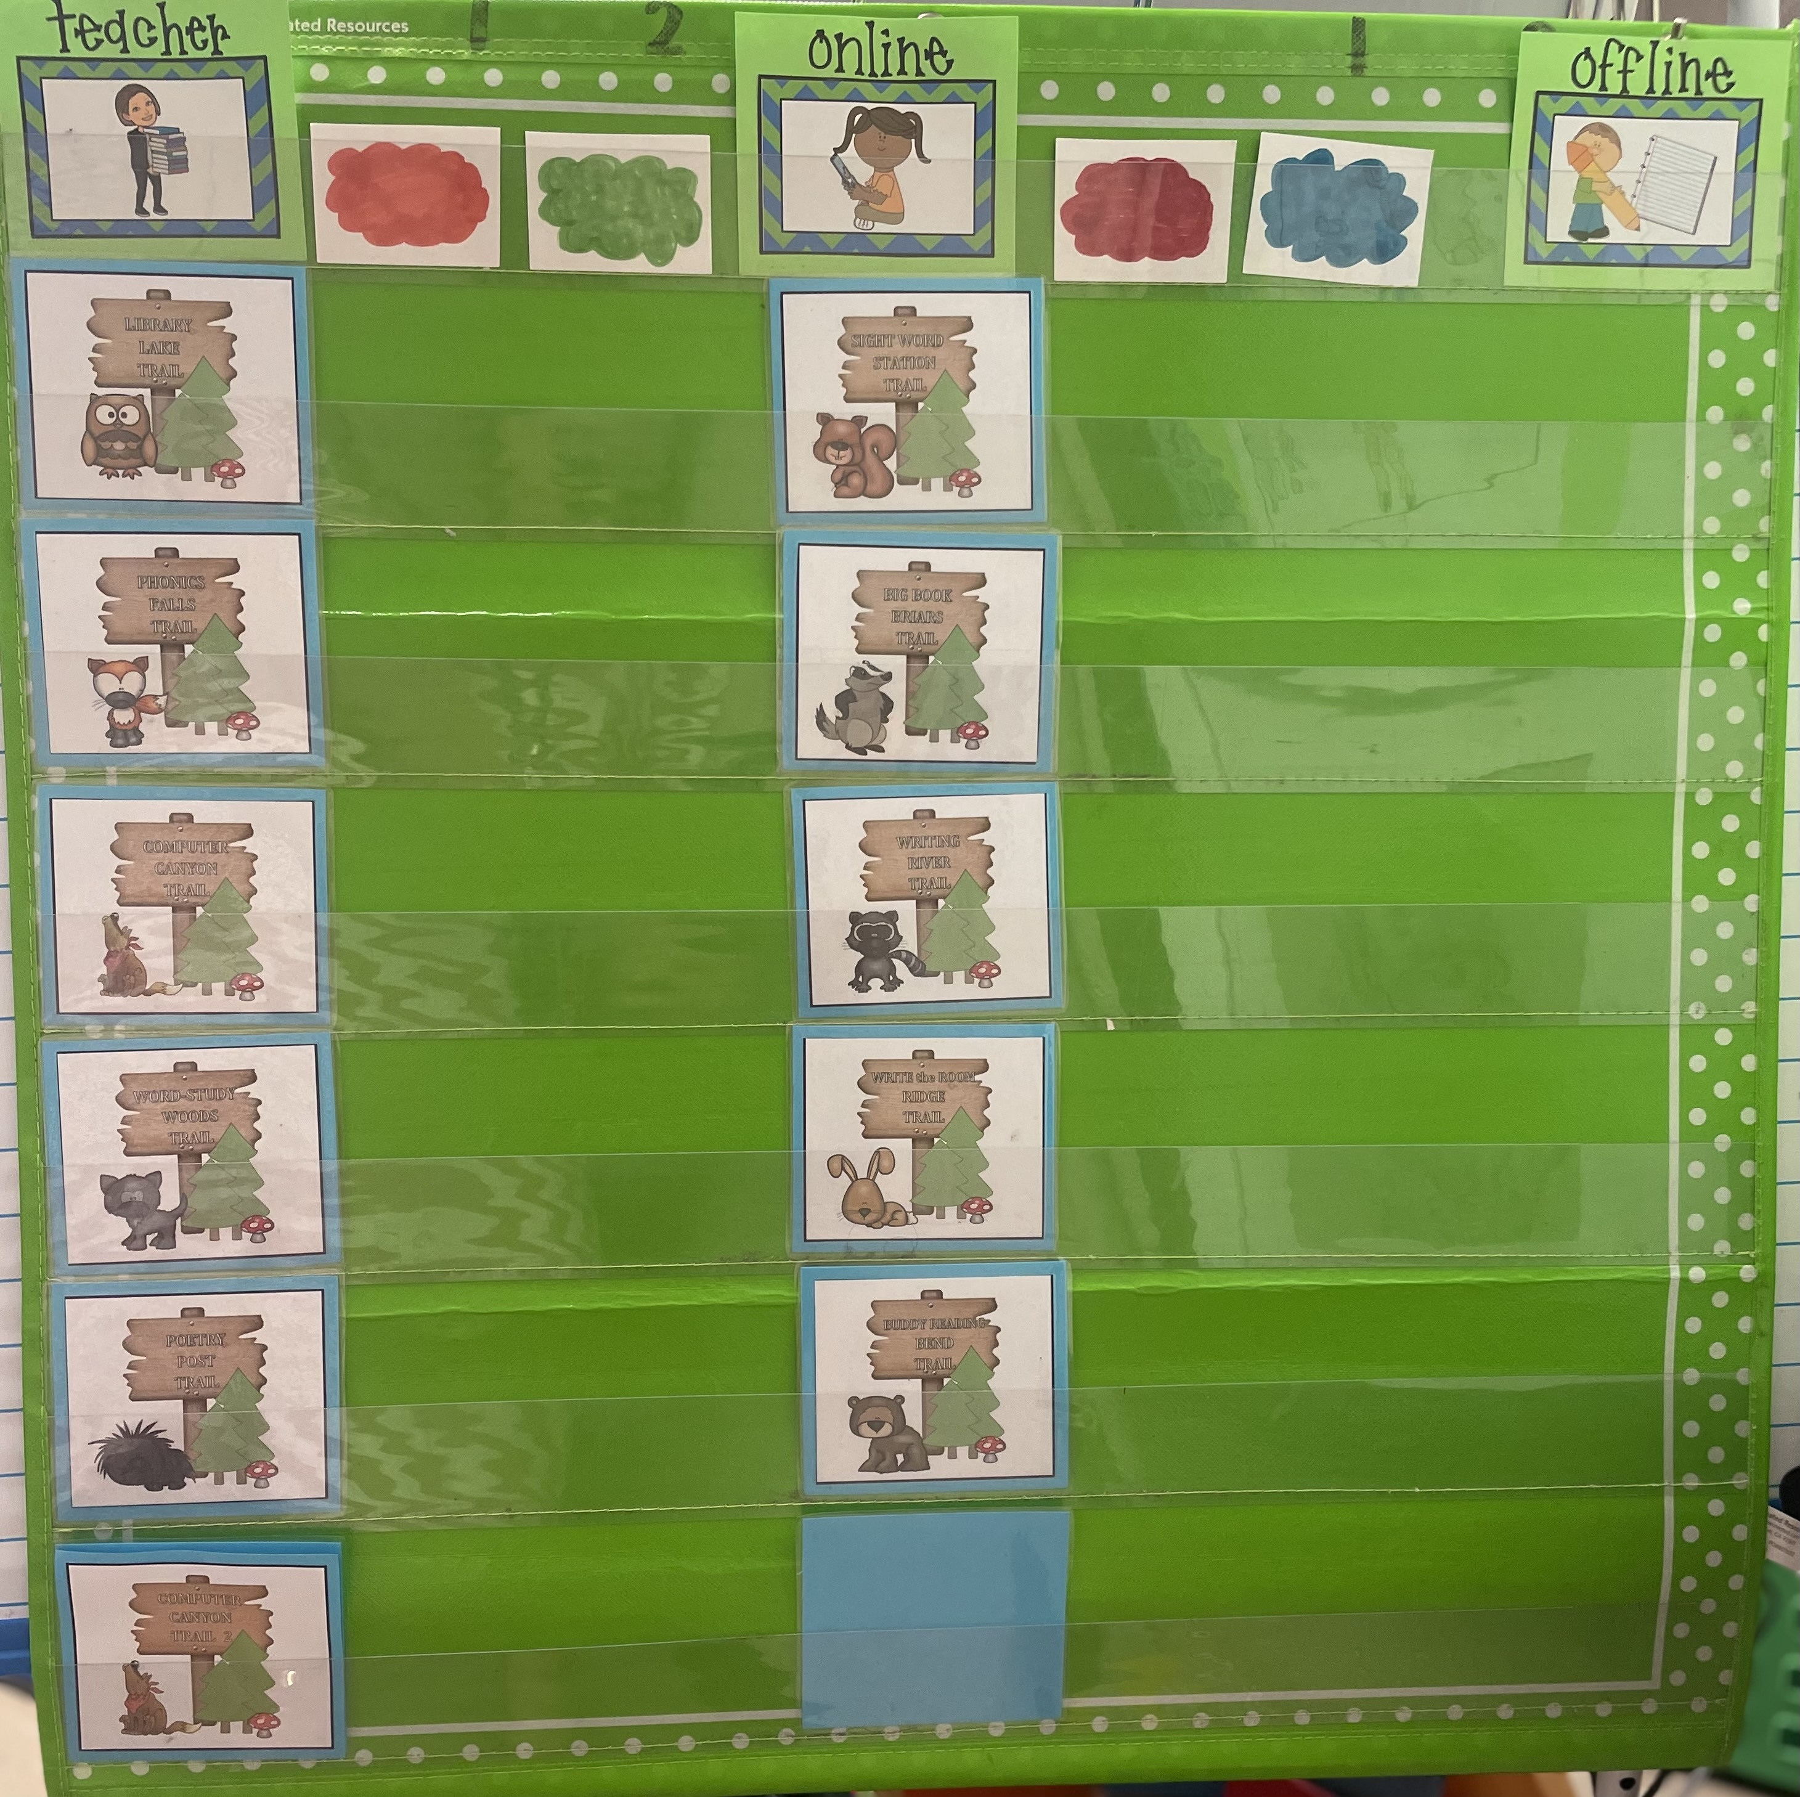
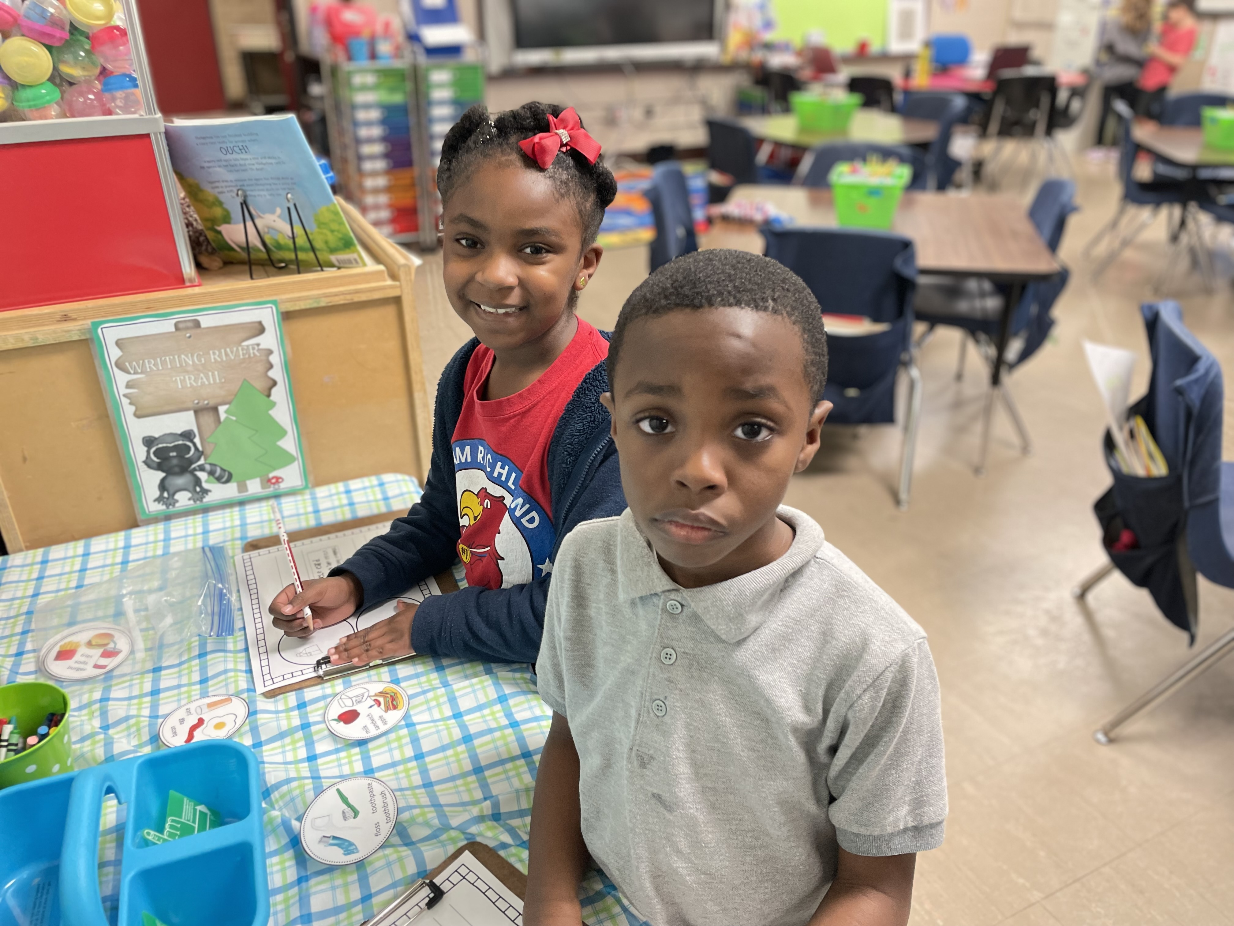
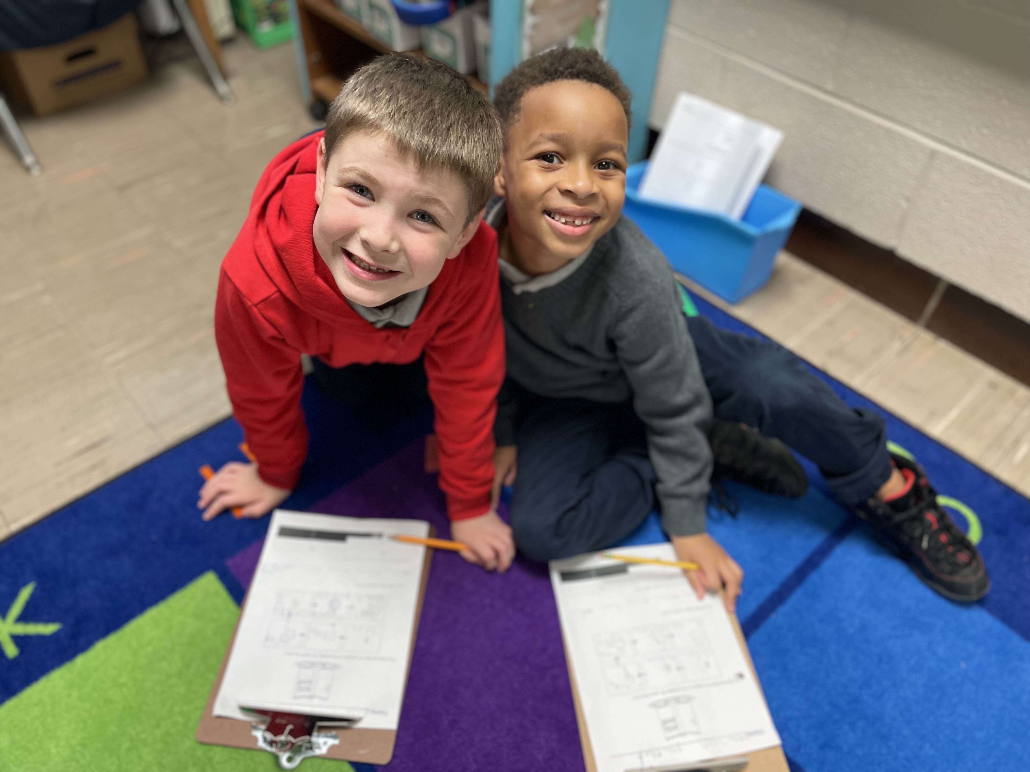
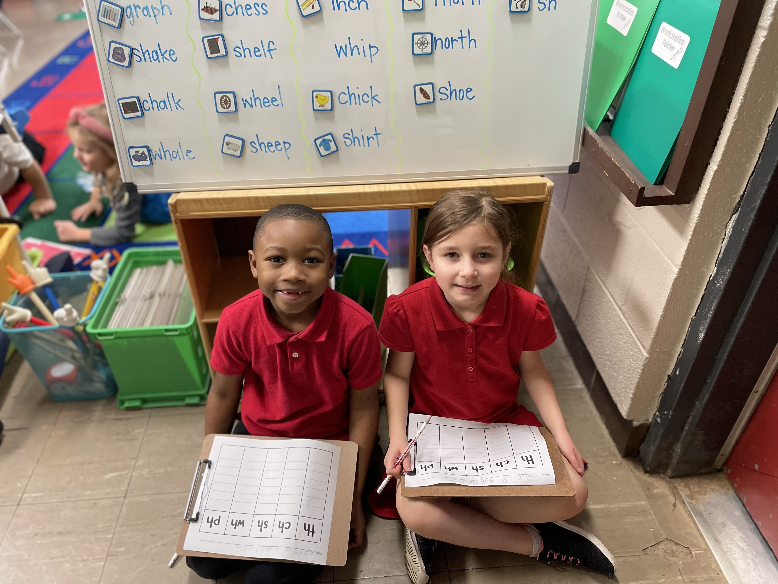
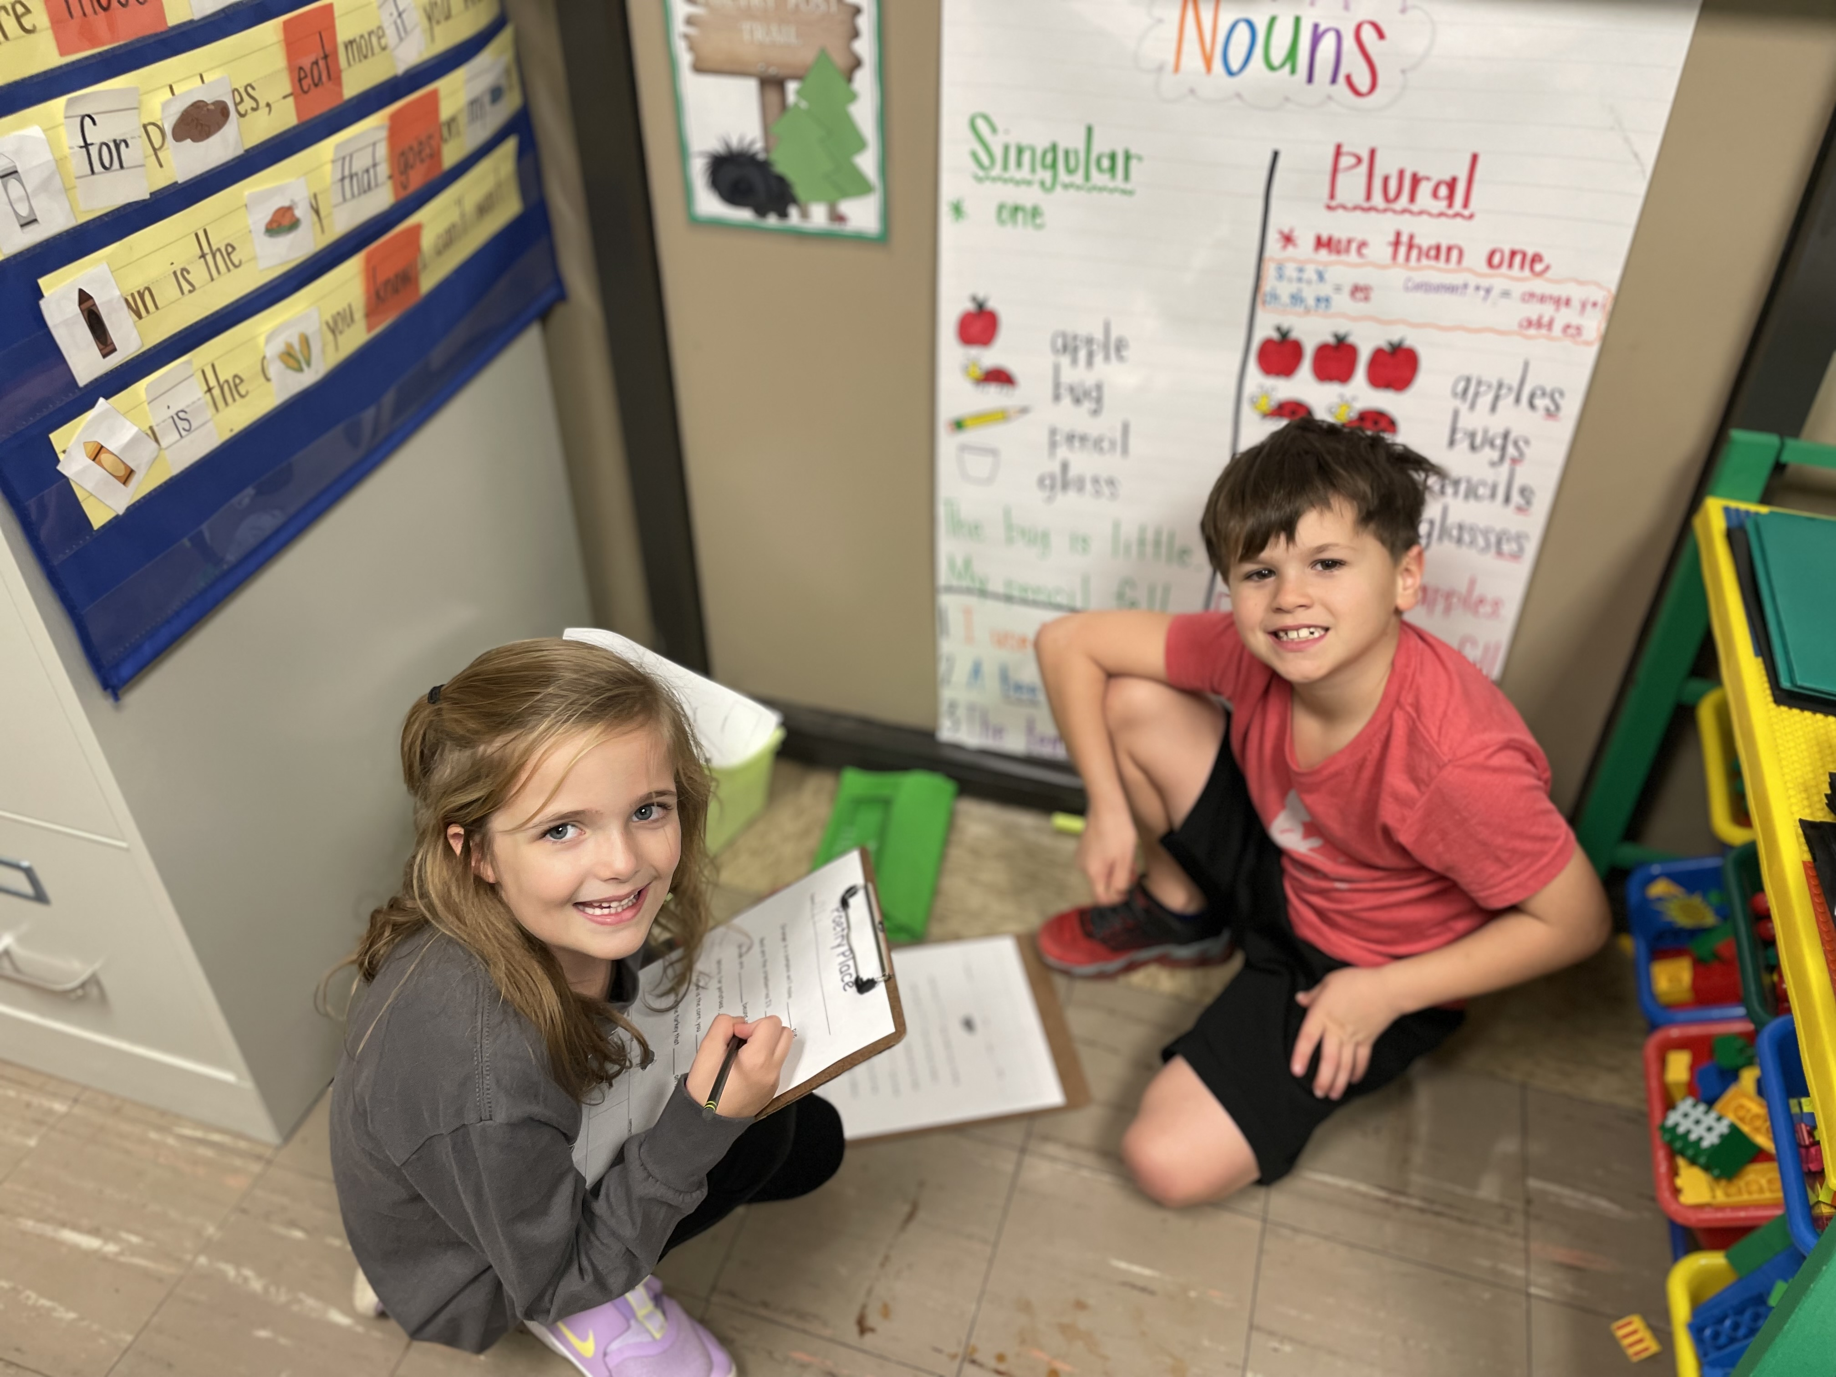
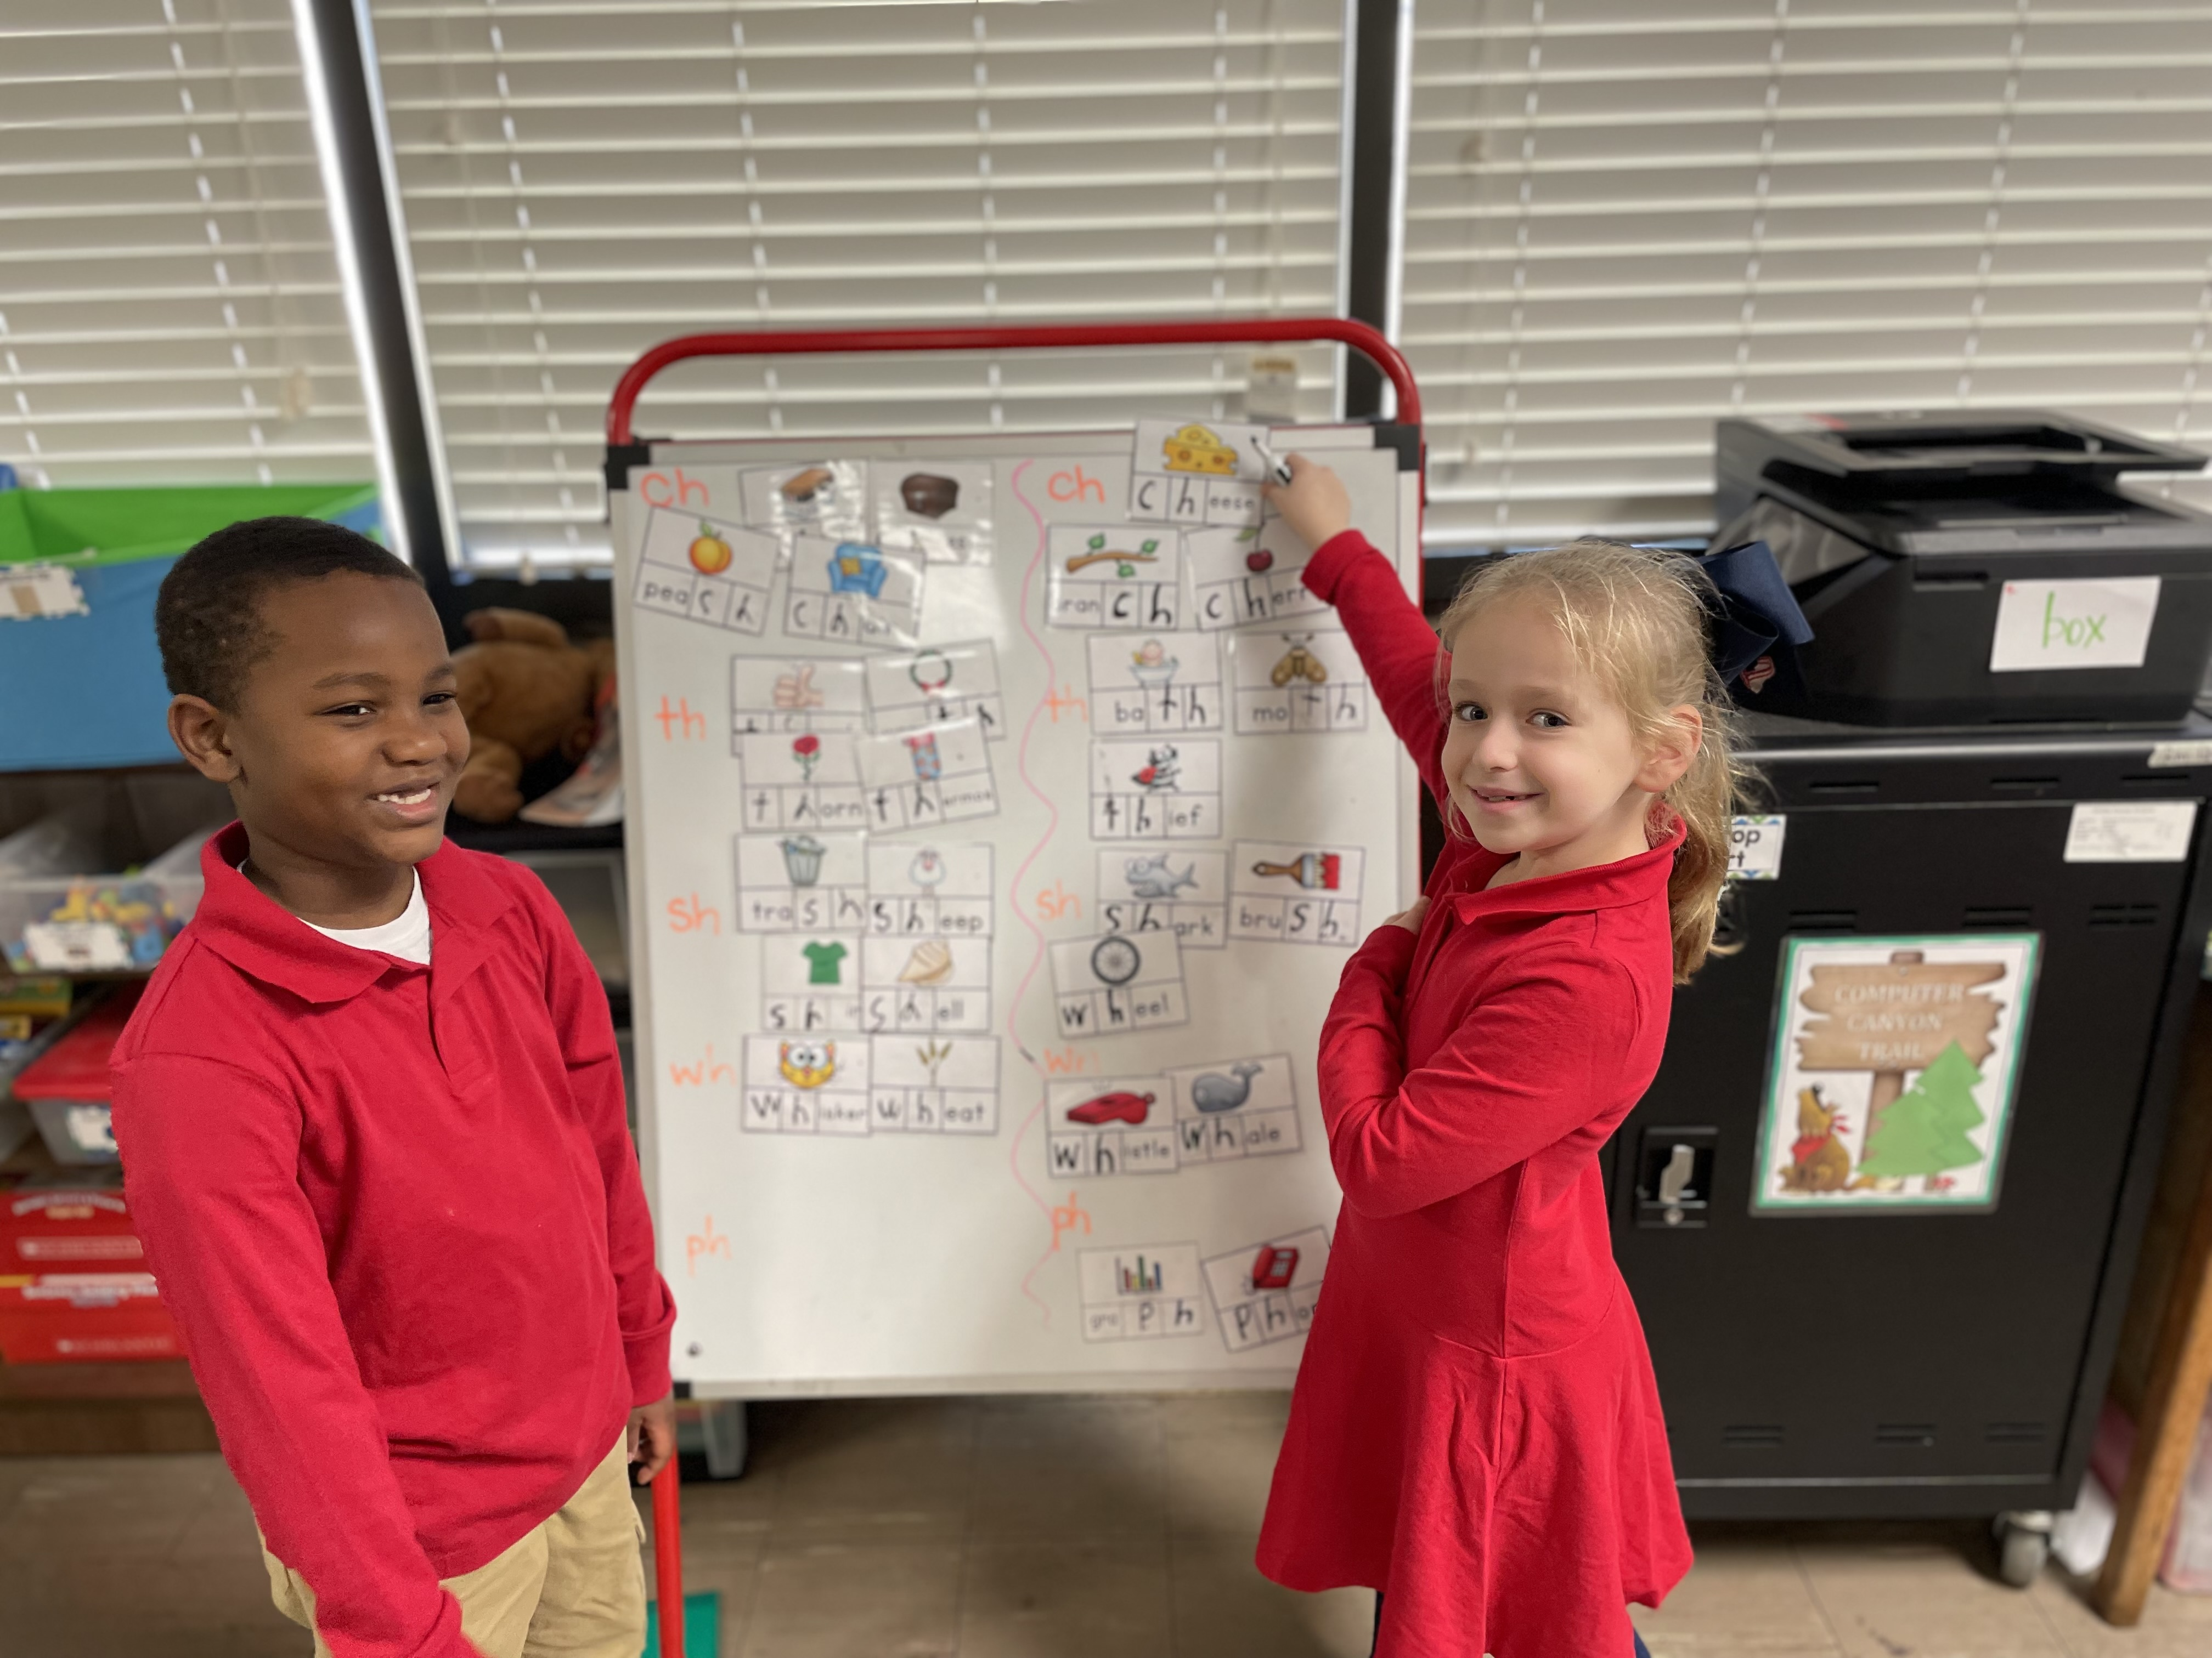
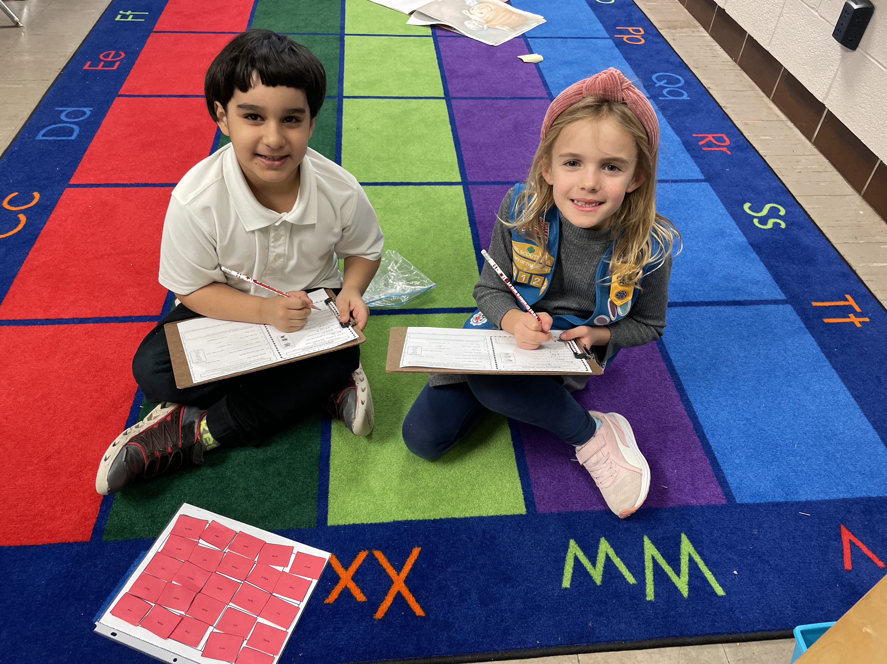
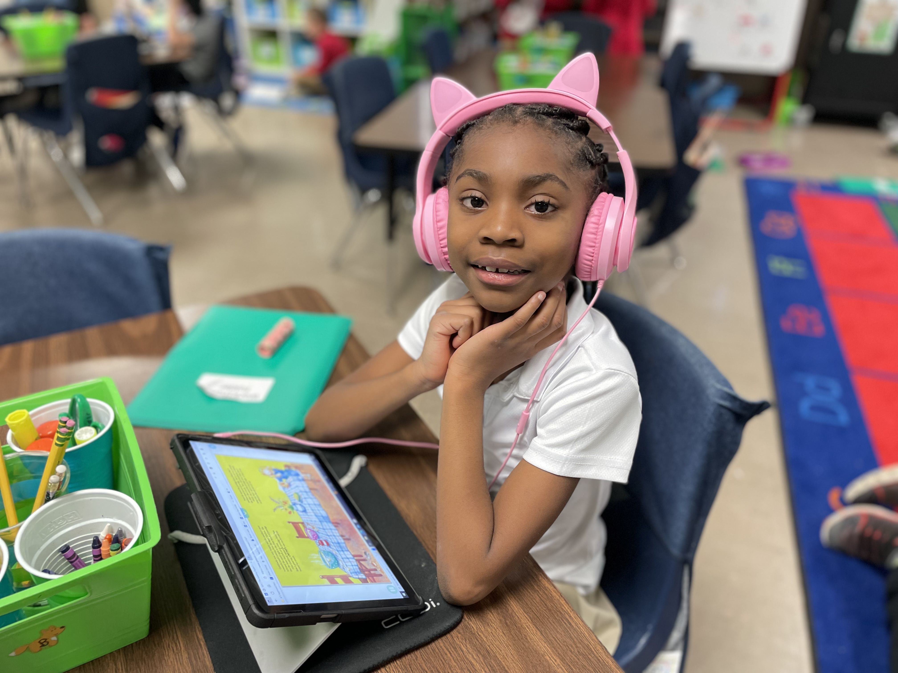
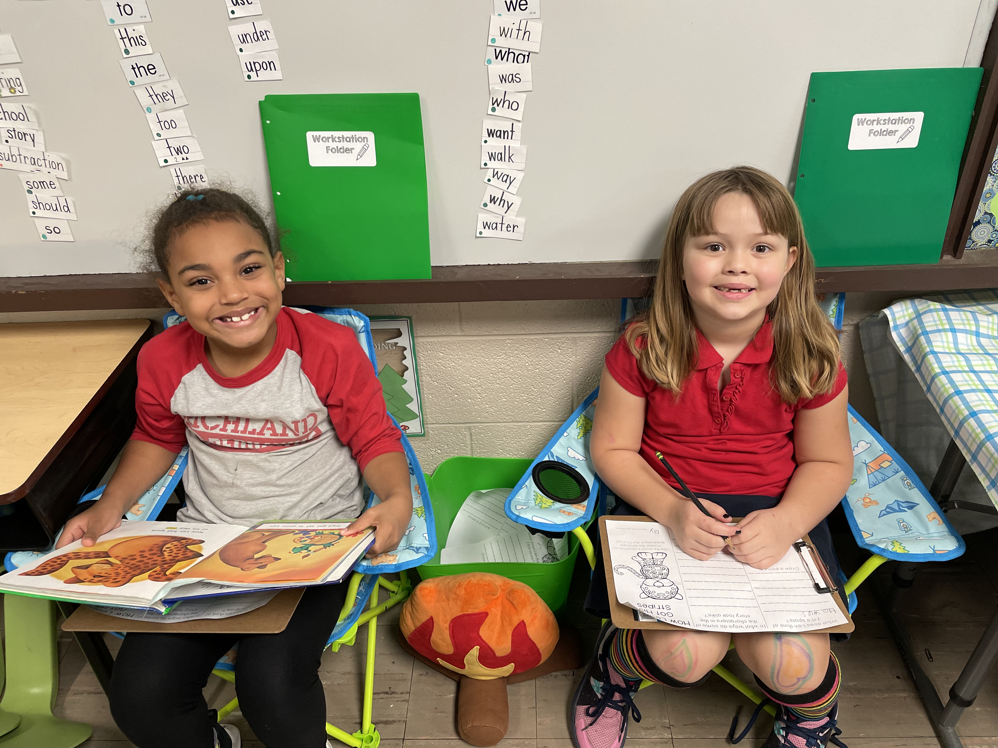
Work Stations

Slide 9
Preparing for School
Students should:
  1. Get a good night’s sleep (in bed by 8:00)
  2. be dressed for school (uniform)
    details on next slide
  3. use the restroom prior to the start of class
  4. bring small water bottle(10”), already filled
  5. have all materials (library books, folders, etc.)

Slide 10
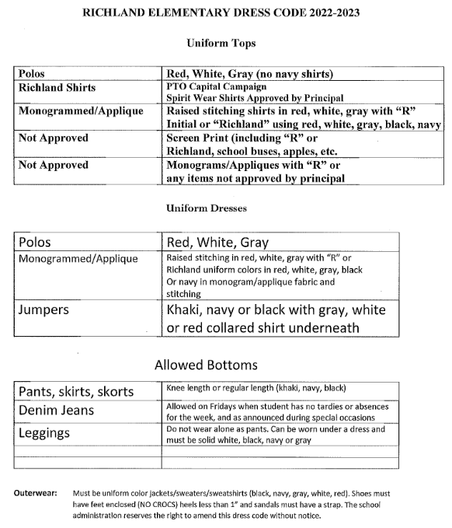
SCHOOL
UNIFORM
GUIDELINES
Please make sure your child is following the uniform policy daily.
1st offense =
friendly reminder
2nd offense =
written notice
3rd offense =
Phone call/conference

Slide 11
Learning Overview
Grading
- participation, classwork, assessments, homework, project
*where will I get the grades?
Platforms (bookmark on tablet)
  - Epic, Seesaw, Boom, Clever, Accelerated Reader
Website
  - check for newsletter, reminders, updates, and important links and projects for our class

Slide 12
Learning Overview
To-Do List:
    Daily = check daily folder and initial, help child complete homework, read with your child, check tablet for updates, shut down and charge device
    Weekly = check teacher website, check
    PowerSchool and have child complete any missing
    or incomplete work

Slide 13
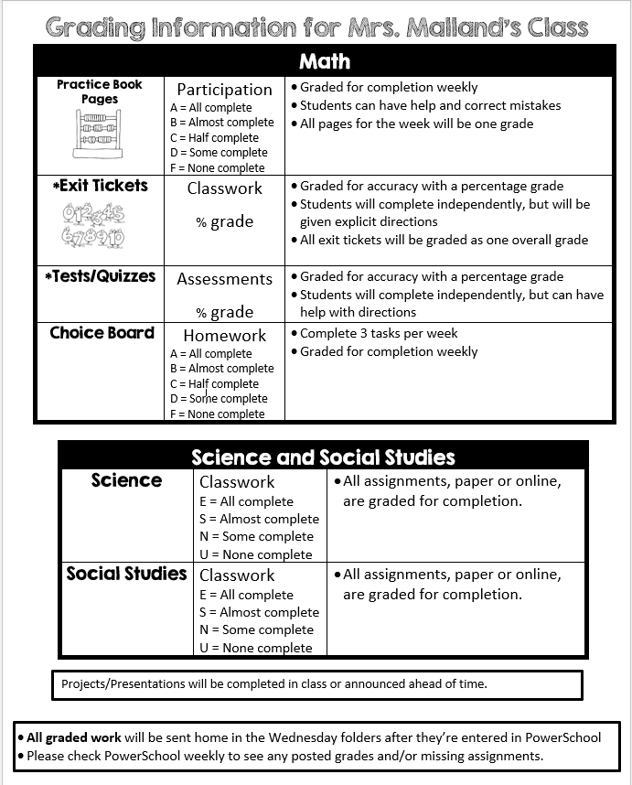
Grading

Slide 14
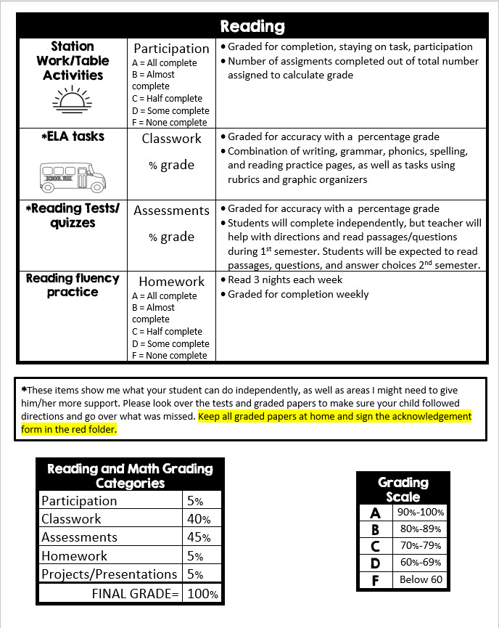
Grading

Slide 15
Tests
ELA
  Every Friday – These tests will include cold reads for comprehension, sight words, phonics skills from the week, grammar skills from the week.
  Students will take a sight words test at the end of each unit
MATH
  Unit tests at the end of each (will be noted in newsletter)
  Quizzes

Slide 16
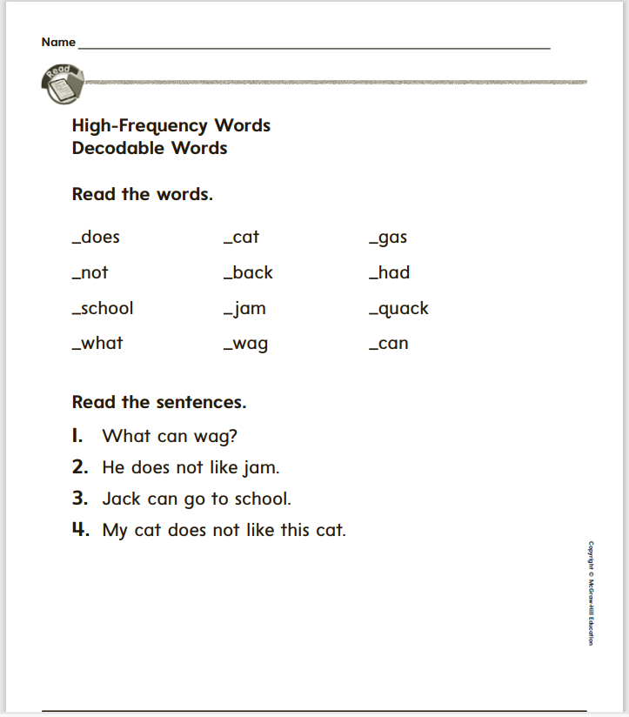
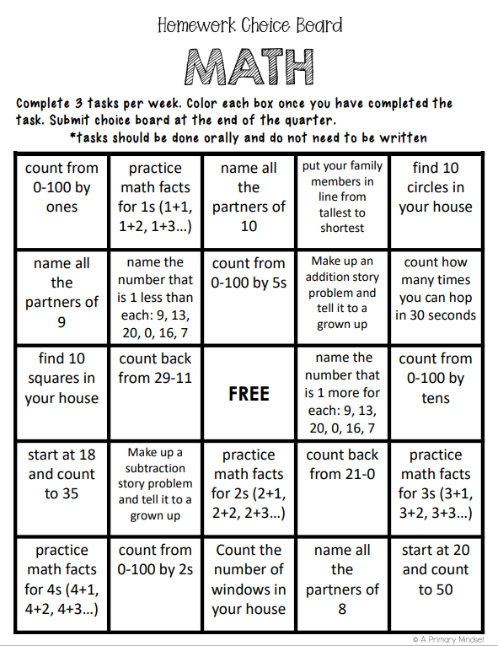
Homework
ELA & MATH (homework grades are required
by the district)
  1. Fluency Reading & Math Choice Board
    - Students will “read” 3 times per week
    - Students will complete 3 tasks on the math choice board per week
    - Weekly homework grades will be given based on completion of weekly expectations
  2. Written (Optional)
    - Students can also complete homework assignments from weekly newsletter
    - There will be 2 each night (1 for math and 1 for ELA)
    - Should only take about 10 minutes to complete
    -- assignments do not need to be turned in
    NEWSLETTER

Slide 17
Ulo Nvntiv Spelg
HOLD BACK THE URGE TO CORRECT
INVENTIVE SPELLING:
  Increased engagement in and enjoyment of writing
  Increased self-confidence as a writer
  Results in greater creative expression and practice of the whole writing process
  Gives students extra practice in phonics
  Better long-term writing skills ( they will write more; the more you write the better you will become)
  Connected to better reading!!
    Because using invented spelling requires a child to think more deeply about the components and phonetic parts of a word than memorizing the spelling, it allows for better learning and deeper understanding of language.
    Children build “dictionaries” of these words (and eventually correct spelling) which allows for greater fluency and automaticity in reading and writing
***It is a predictor of growth in early reading skills, over and above knowledge of alphabet and phonological awareness!

Slide 18
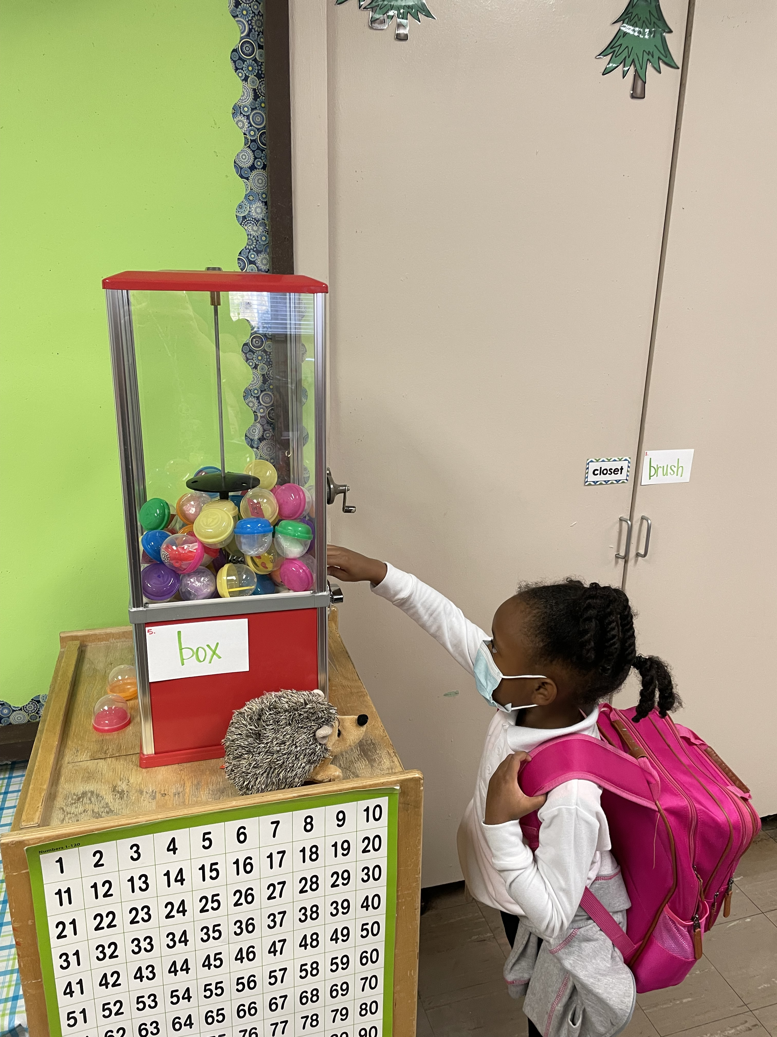
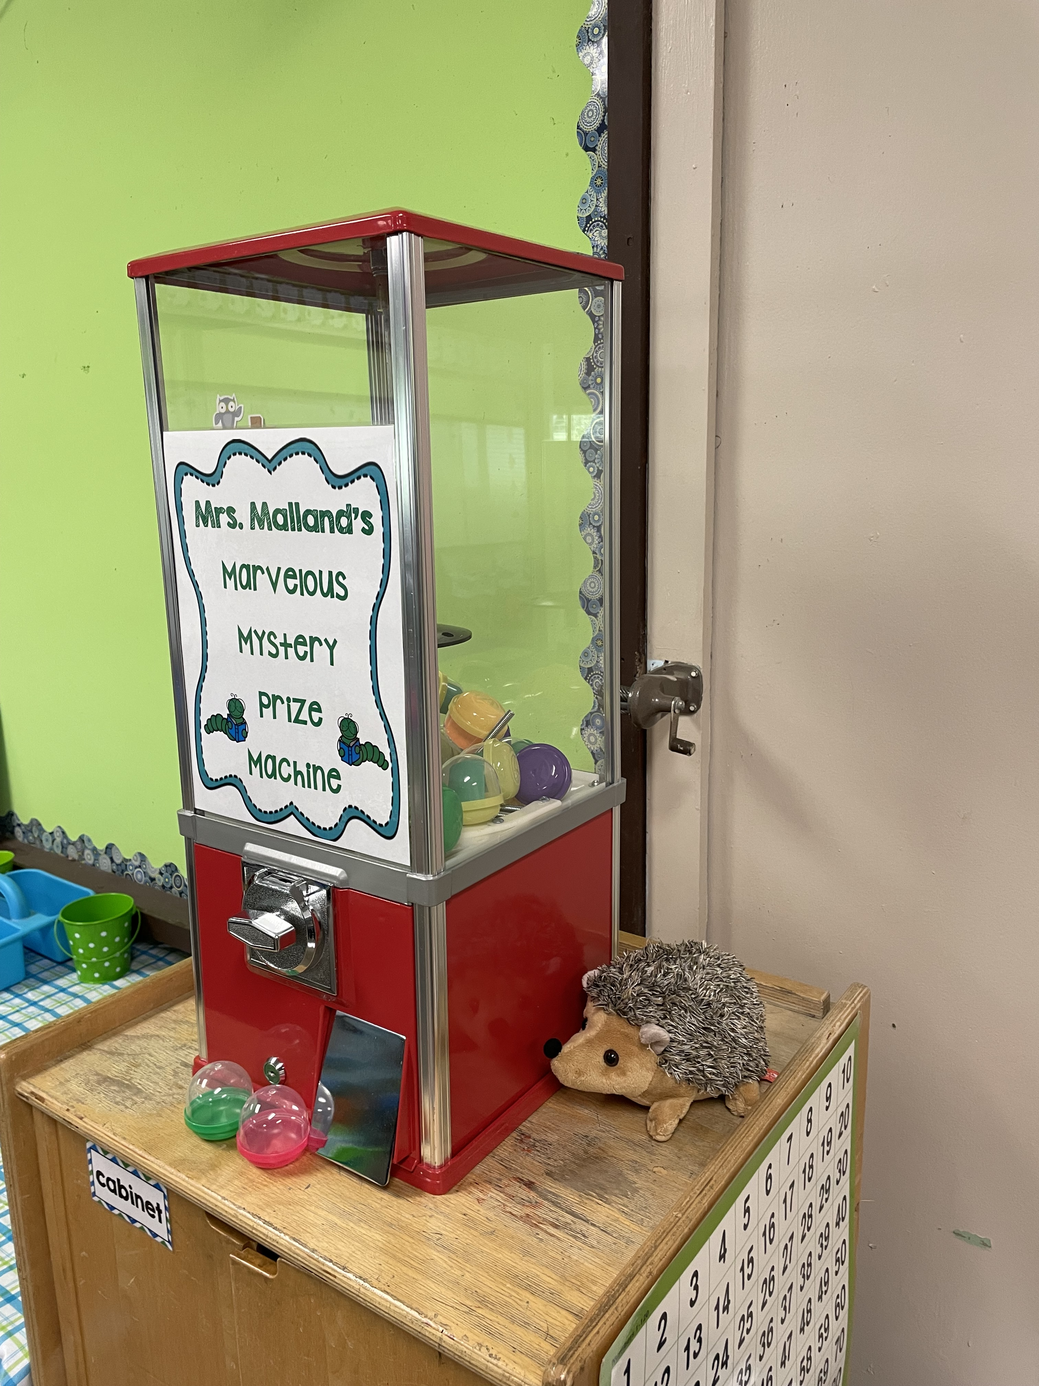
Mystery Prize Machine
Students earn tokens by reading books
Tokens are used to go to the mystery prize machine
A token is issued each time the reading log is completed.

Slide 19
Boom Cards
How do Boom Cards Work?
-students log in with Boom!
-select decks starting from top, completing an ela and a
math each night
-decks can be redone if needed
STUDENT LOG IN
BOOM CARDS STEP SHEET
BOOM CARDS FAQs AND INFORMATION

Slide 20
Conduct
First graders will continue to receive conduct grades,
(E, G, S, N, U)
**Students will be chosen for a weekend with our class “pet” based on weekly behavior
Work Habits/Behaviors
- 1st and last name, write with a pencil, neat, complete work and on time
- materials ready (tablets), follow directions 1st time, limit distractions for self and others, raise hand for questions
and needs, talk during designated times and activities

Slide 21
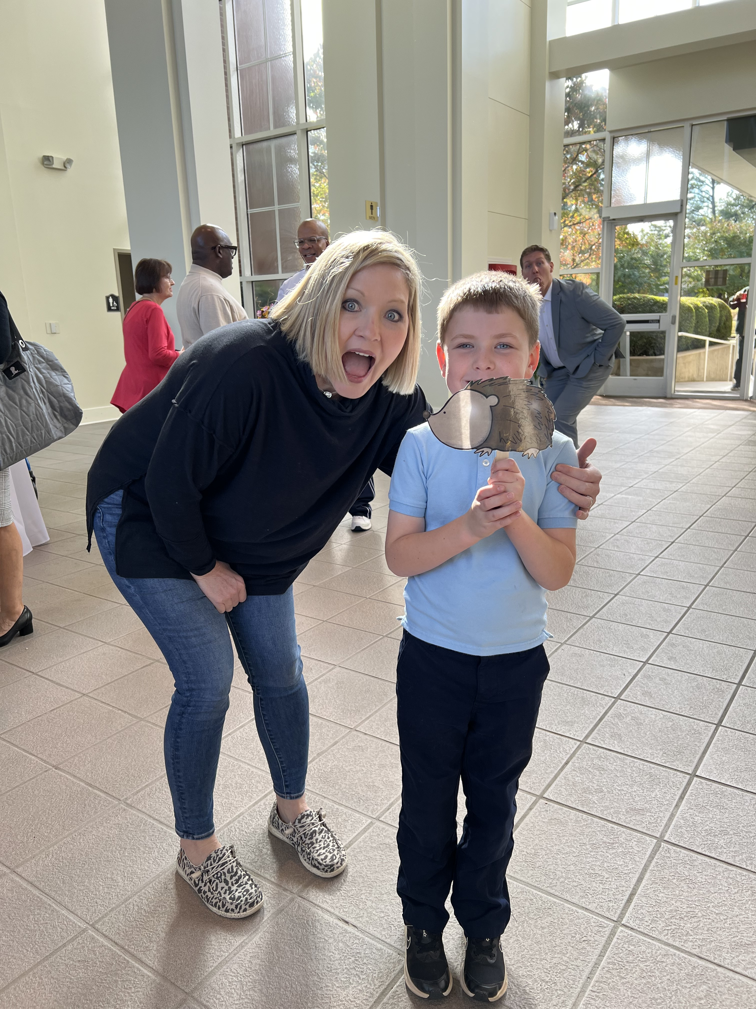
Our Weekend Buddy
Sent home as a reward for excellent conduct
Joins your family for a weekend
Write short descriptions about your adventures.
Take pictures and email them to me
Your child will share the pictures and journal with the class on Monday

Slide 22
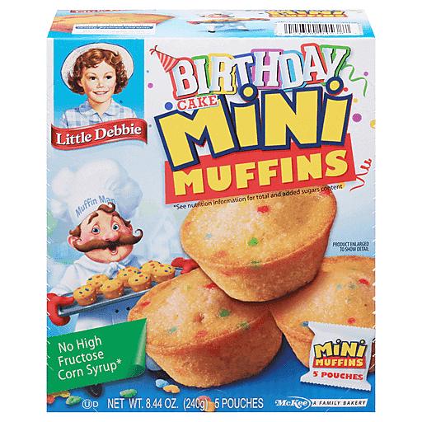
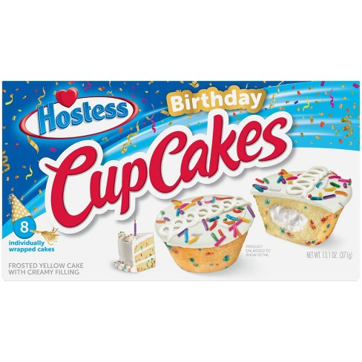
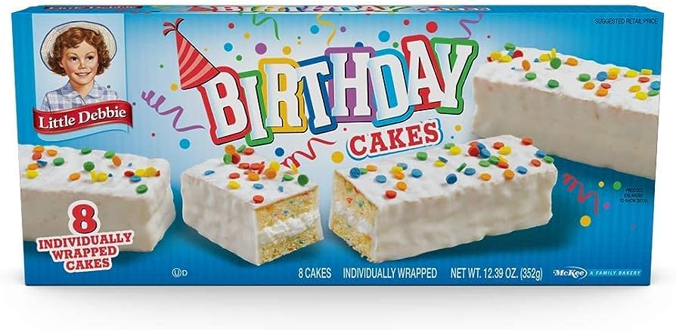
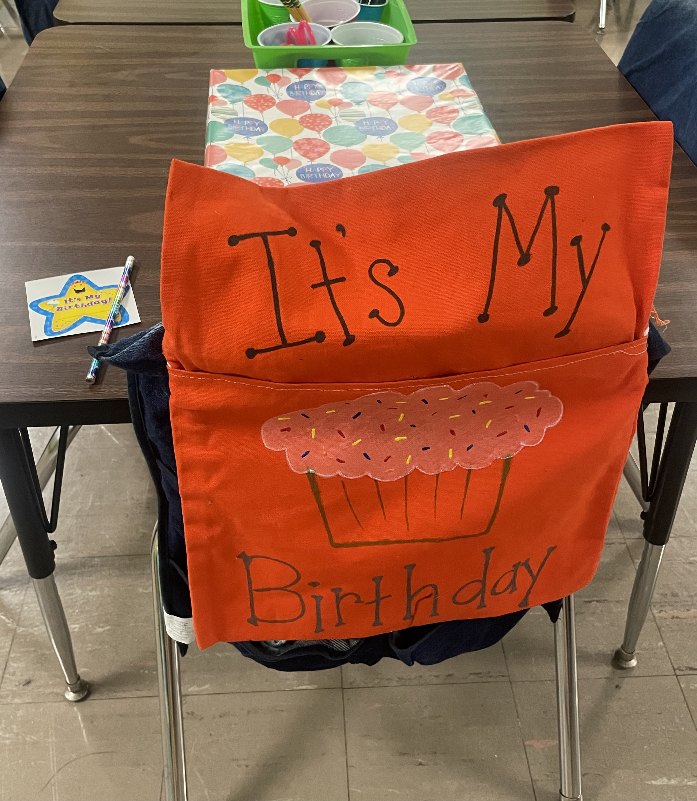
Birthdays
birthday cupcakes are not permitted to be served at school
goodie bags can be sent with child and distributed at end of the day
invitations sent home through me must go to every classmate
every child will be made to feel extra special on his/her birthday
(chair bag, pencil, sticker, birthday box)

Slide 23
Miscellaneous
Bookmark Boom, Seesaw, Epic (nnh5212) on devices
iReady
Info sheet
Join Remind
Class email list
Absences
Reading log/goals
Check Richland and SCS websites regularly
Dismissal changes
Jackets/sweaters
Water bottles (small)
snacks
Playground permission slips

Slide 24

Contact and Information Resources
Text via Remind
text @malland24 to 81010
Email
mallando@bellsouth.net
Mallandoa@scsk12.org
Newsletter
teacher website
https://bit.ly/3A3Hm2u

Slide 25
Homework
ELA & MATH (homework grades are required by district)
  There are 2 options for homework:
  1. Digital (Boom Cards)
    - Students will complete decks of assigned boom cards that will align with
    our weekly skills.
    - There will be 2 decks each night (1 for math and 1 for ELA)
    - Should only take about 10 minutes to complete
  2. Written
    - Students will complete all homework assignments from weekly newsletter
    - There will be 2 each night (1 for math and 1 for ELA)
    - Should only take about 10 minutes to complete
    -- All assignments will be kept and turned in together on Friday
    NEWSLETTER

